Slide 1


Global Stock Investments

Slide 2


Contents
Introduction
Problem Statement
Solution
Object Model
Use Cases
Scope

Slide 3
Introduction
A stock market is an aggregation of buyers and sellers of stocks (also called as shares) which represent ownership claims on businesses.
It refers to the collection of markets and exchanges where the issuing and trading of stocks takes place either through formal exchange or over-the-counter.
It is one of the most vital components of a free-market economy as well as one the many potential places to invest your money because it provides access to capital in exchange for giving investors a slice of ownership.
Investment in stock is often risky but if you manage the risks, you can take the advantage of the stock market to secure your financial position and earn money.

Slide 4
Problem Statement
Investments are usually done in an effort to have money to accomplish life goals and realize dreams.
Investors are always curious about investing in the stock market but still confused by its strange terms and confusing headlines.
They may face several investment-related queries and would want to reach out to people for advice in this regard.
Investors also face challenges while maintaining their inventory for tax purposes and actively look for solutions to save time and efforts.

Slide 5


Types of Questions
1. How much risk should I take?
2. How do I choose the funds to invest in? 3. Who should I reach out to for advice? 4. How challenging would be stock inventory management and reporting to government?

Slide 6
Solution
Our project is Global Stock Investments designed to help individuals allocate, manage and report their resources in the stock market effectively in order to bring their portfolio to a success.
The management is executed in accordance with a specific investment goal and takes into consideration the level of risk that the investor seeks.
The investors also has the opportunity to seek investment advice for both local and global markets as well as gain more knowledge and be more literate to decide upon their future investments.
The system also provides the feature to effectively report customer investments to government thereby reducing some burden off them along with the ability to identify risks during stock purchases.

Slide 7
Object Model

Slide 8
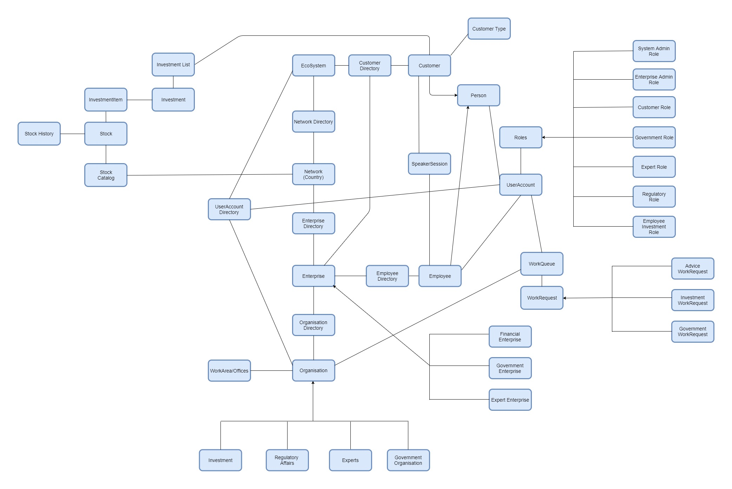

Slide 9
Actors and Key Roles

Slide 10

Customer:
i. Request Expert or Employee for stock investment advice
ii. Register for Expert Speaker Session for various topics related to investments
iii. Request Investment Employee to make desired investments in global markets
iv. Compare Stock History of various stocks
v. View Advice history and Investment history

Slide 11

Investment Employee: i. Advices customer for investments in local or global stock markets ii. Manages (buy or sell) customer investments iii. Generate reports for customer investments Regulatory Employee: i. Respond to Government request for customer investments Government Employee: i. Request Regulatory employee for customer investments ii. Analyze customers’ global investments

Slide 12
Use Cases

Slide 13
System Administrator

Slide 14
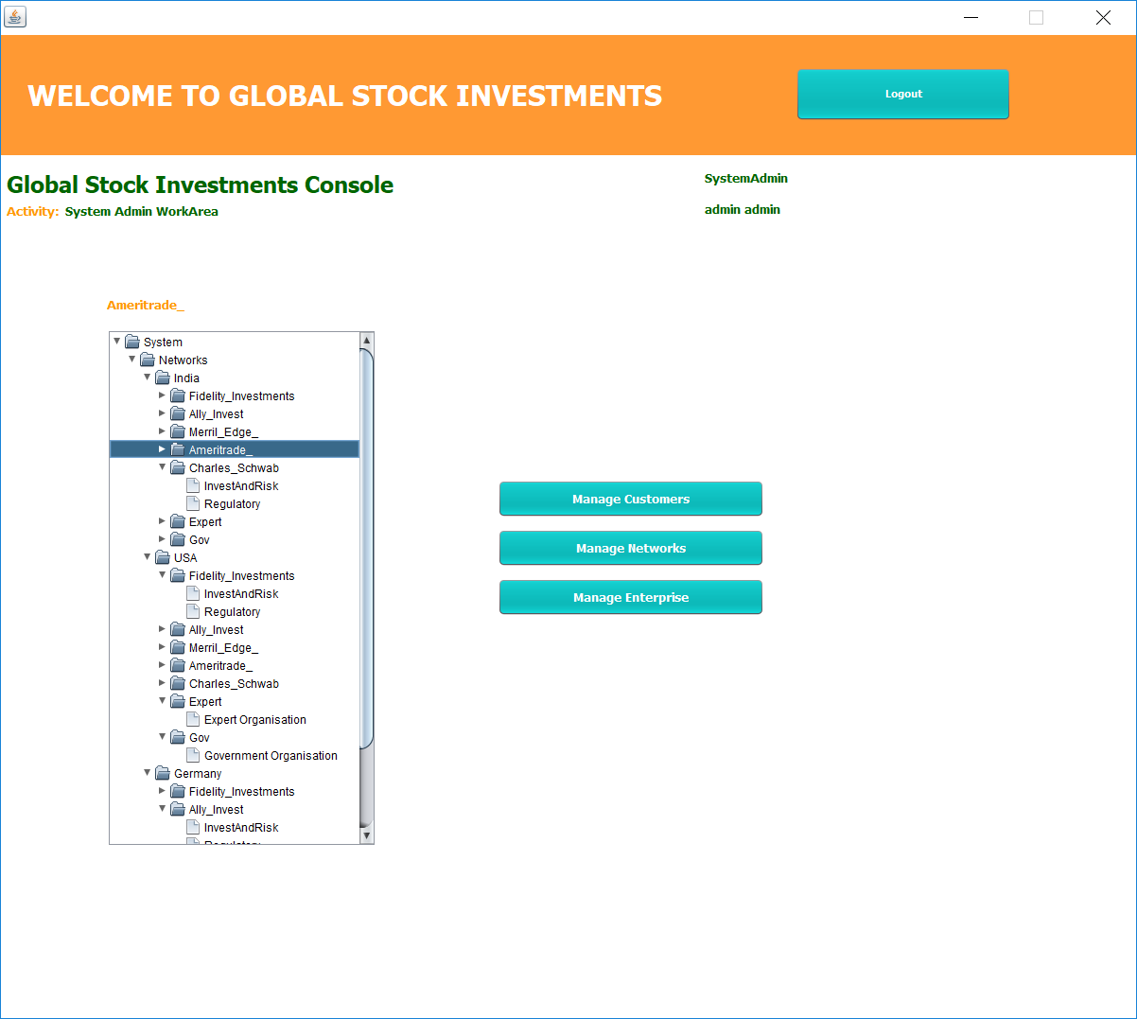
System Admin has access to entire system
He will be able to manage (add, delete/disable, view update) Customer details, Network information as well as Enterpise along with its admin
System Admin WorkArea

Slide 15
Enterprise Administrator

Slide 16
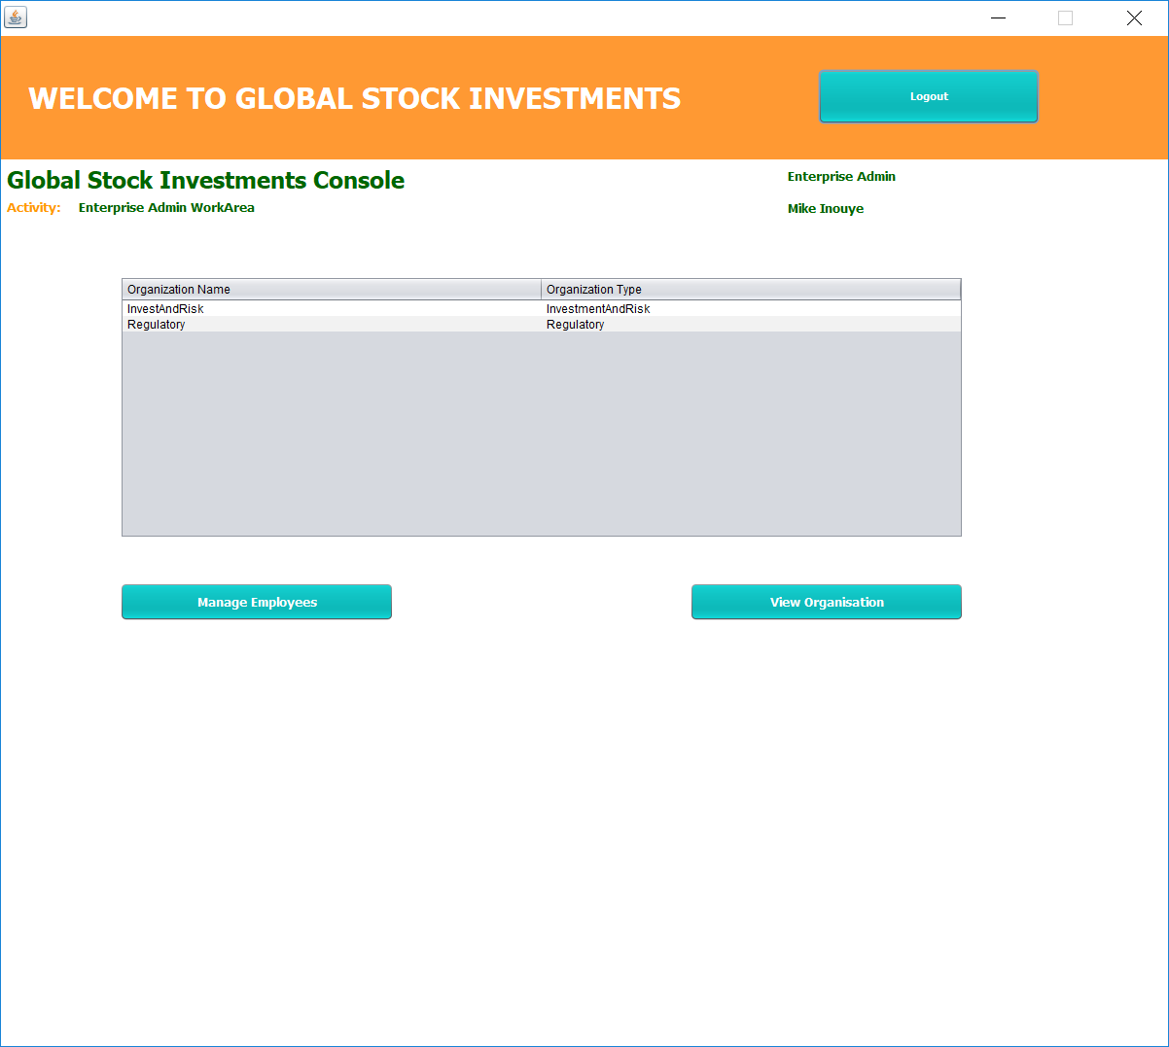
Enterprise Admin will be able to view its various organizations as well as manage its employees
Enterprise Admin WorkArea

Slide 17
Customer

Slide 18
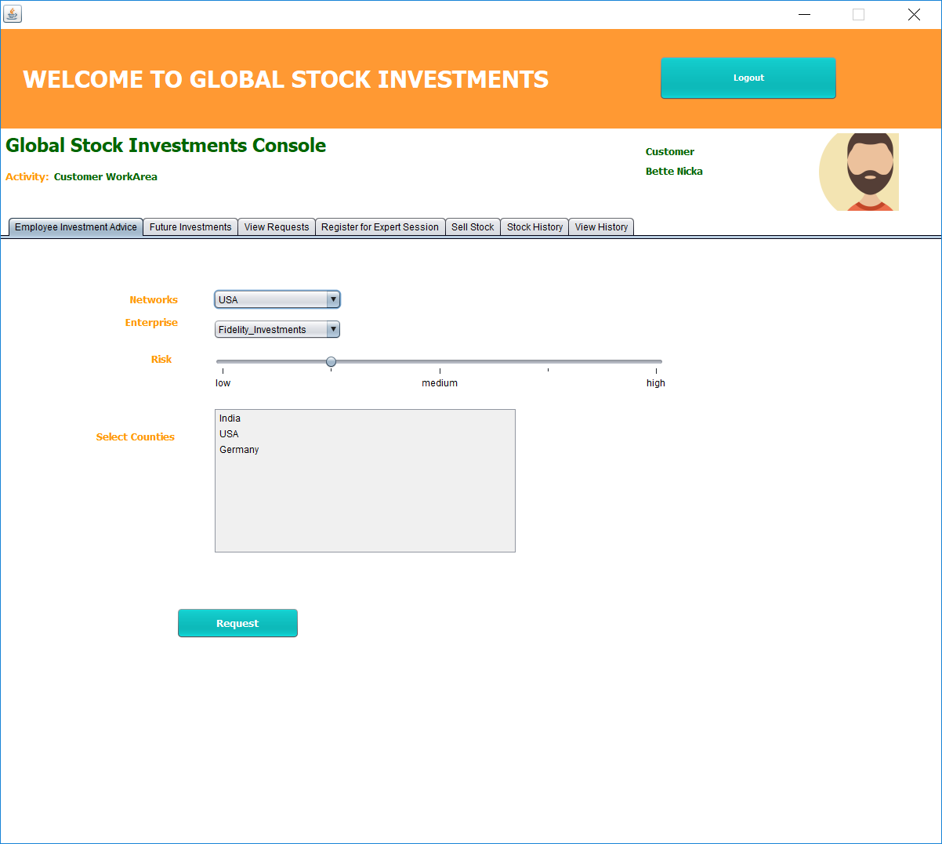
Customer can reach out to Investment Employee to seek advice on global stock investment
Customer WorkArea- Employee Investment Advice

Slide 19
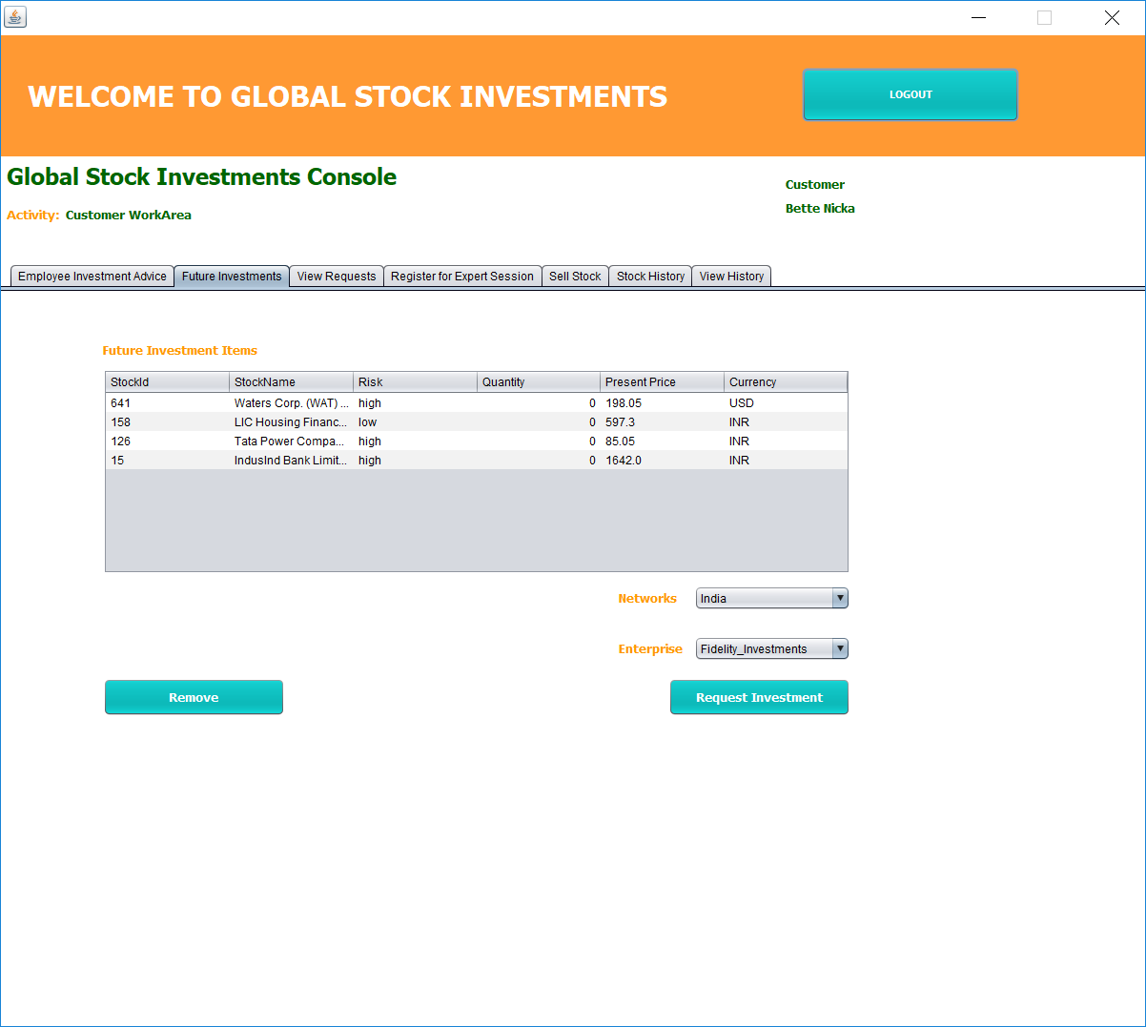
Customer can maintain a list of Stocks for Future Investments
Customer WorkArea- Future Investments

Slide 20
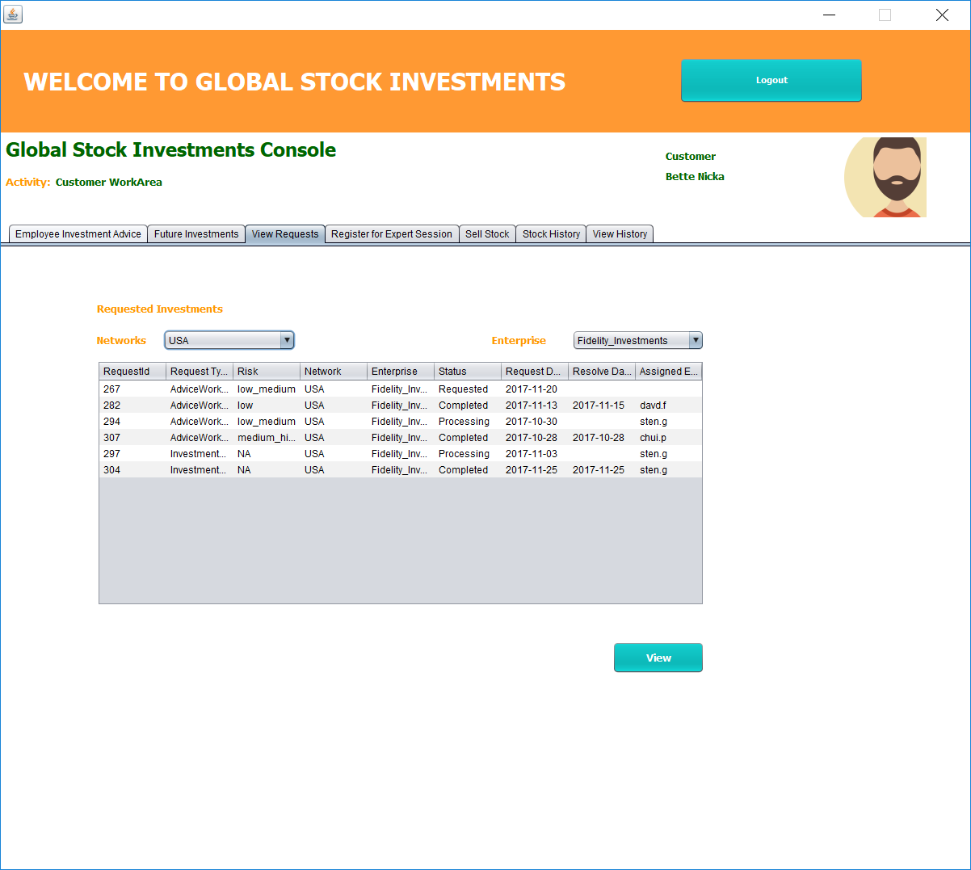
Customer can view both advice as well as investment requests made to Investment Employee and Expert
Customer WorkArea- View Requests

Slide 21
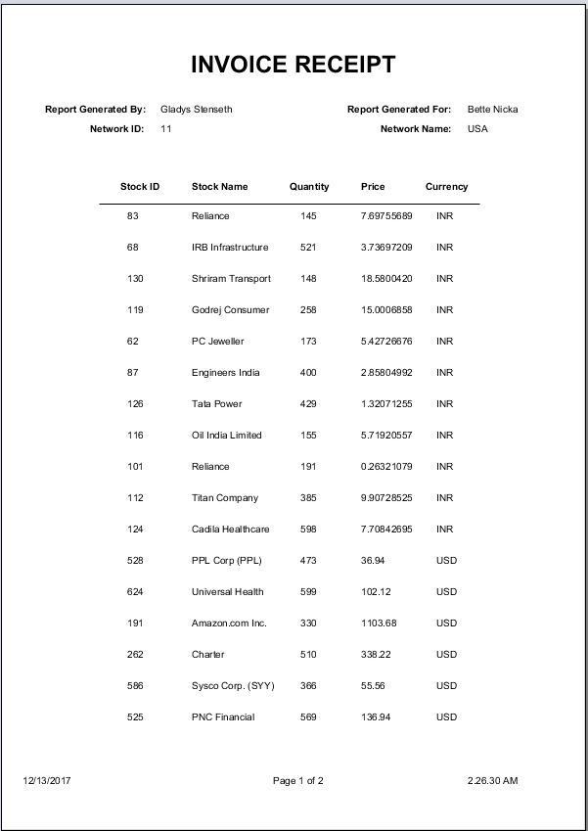

Slide 22
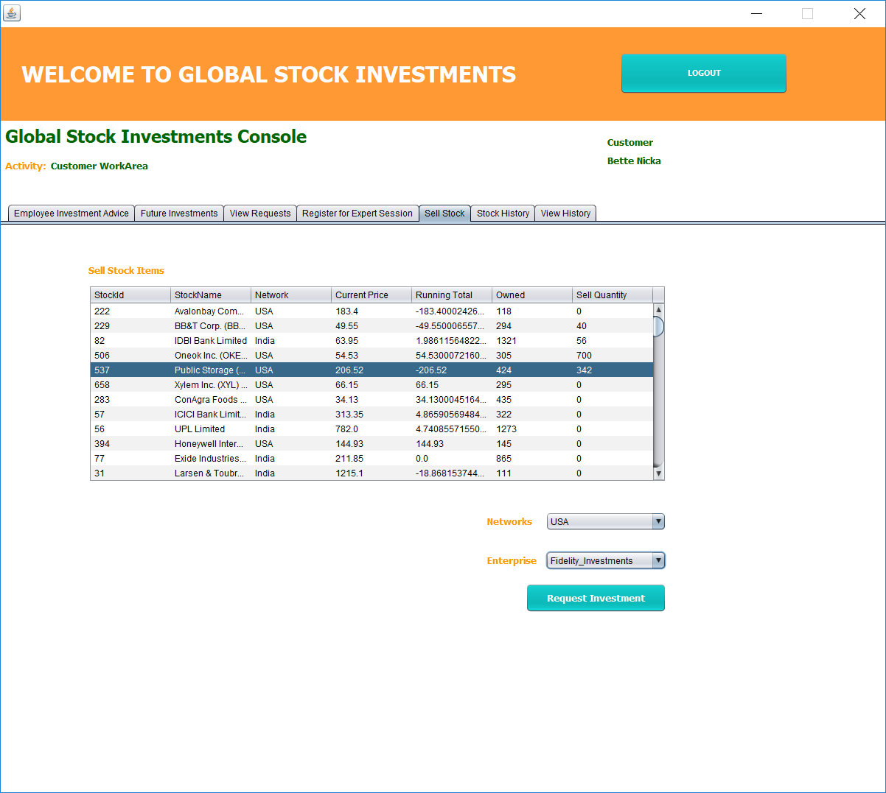
Customer has the ability to request Investment Employee to sell his global stock investments
Customer WorkArea- Sell Stocks

Slide 23
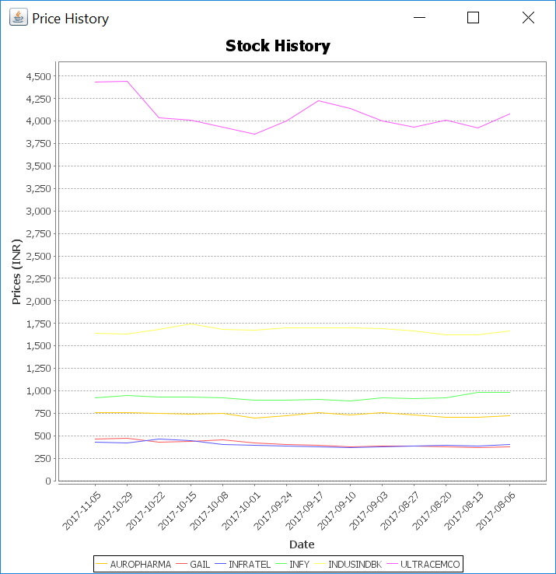
Customer can also view Stock History of multiple stocks to gain better understanding of market
Customer WorkArea- Stock History

Slide 24
Investment and Risk Employee

Slide 25
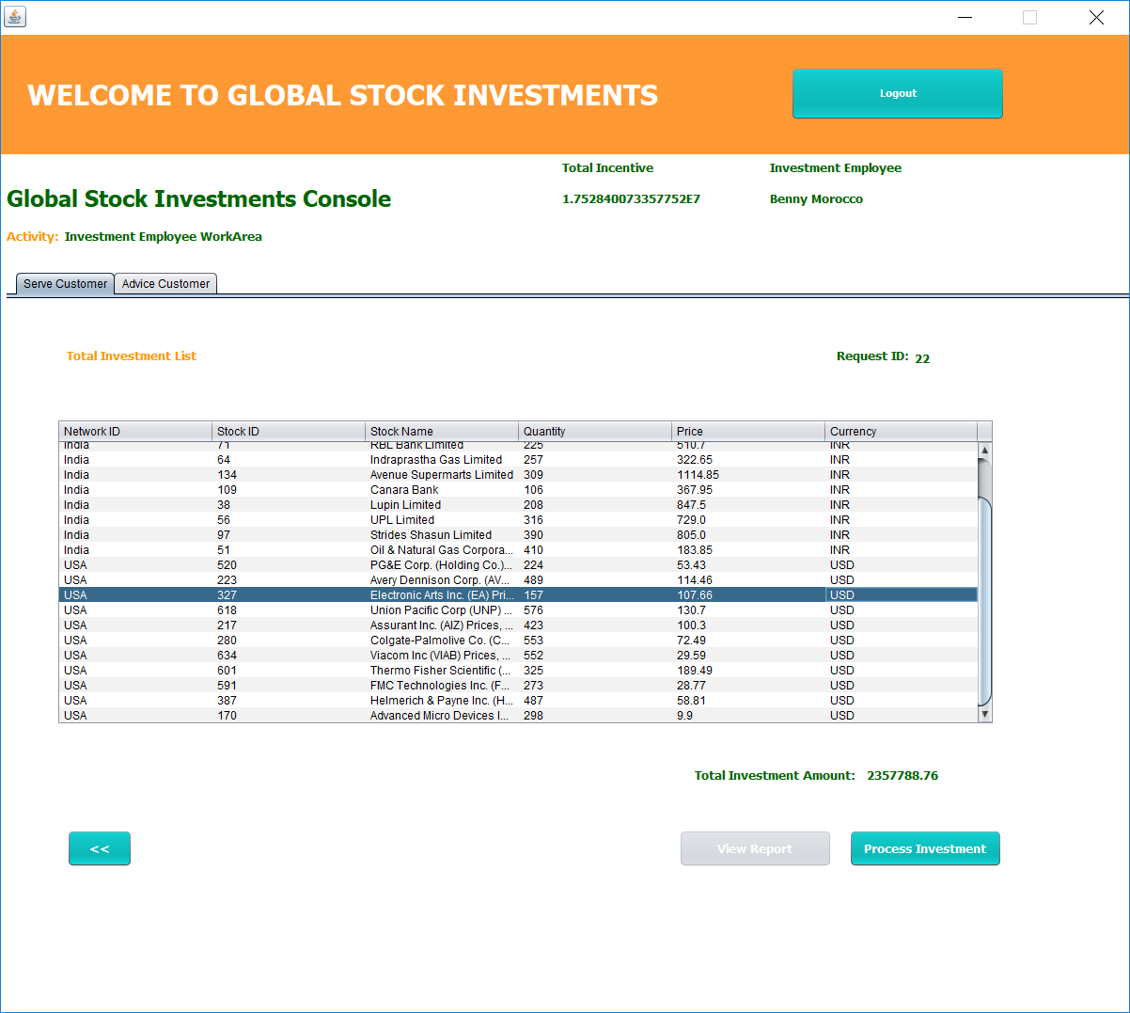
Investment and Risk Employee will serve customer requests for investing in local and global stocks
Investment Employee WorkArea- Serve Customer

Slide 27
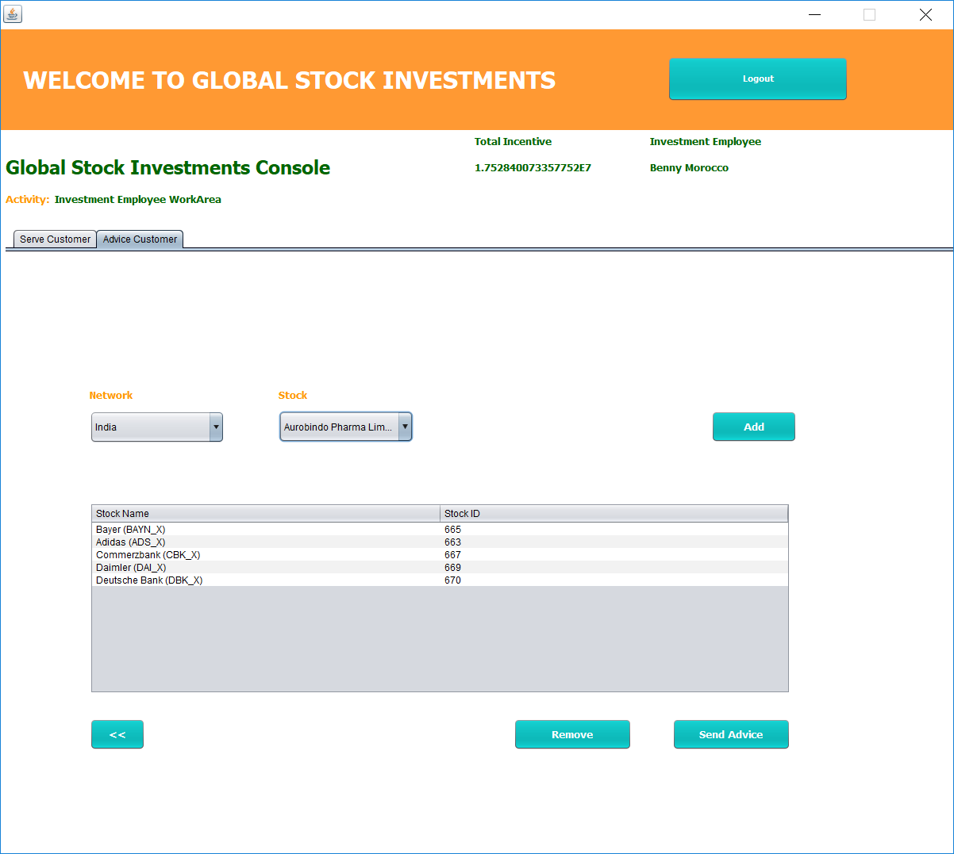
Investment and Risk Employee can also advice customers for effective investments in the stock market bearing risks in mind
Investment Employee WorkArea- Advice Customer

Slide 28
Government Employee

Slide 29
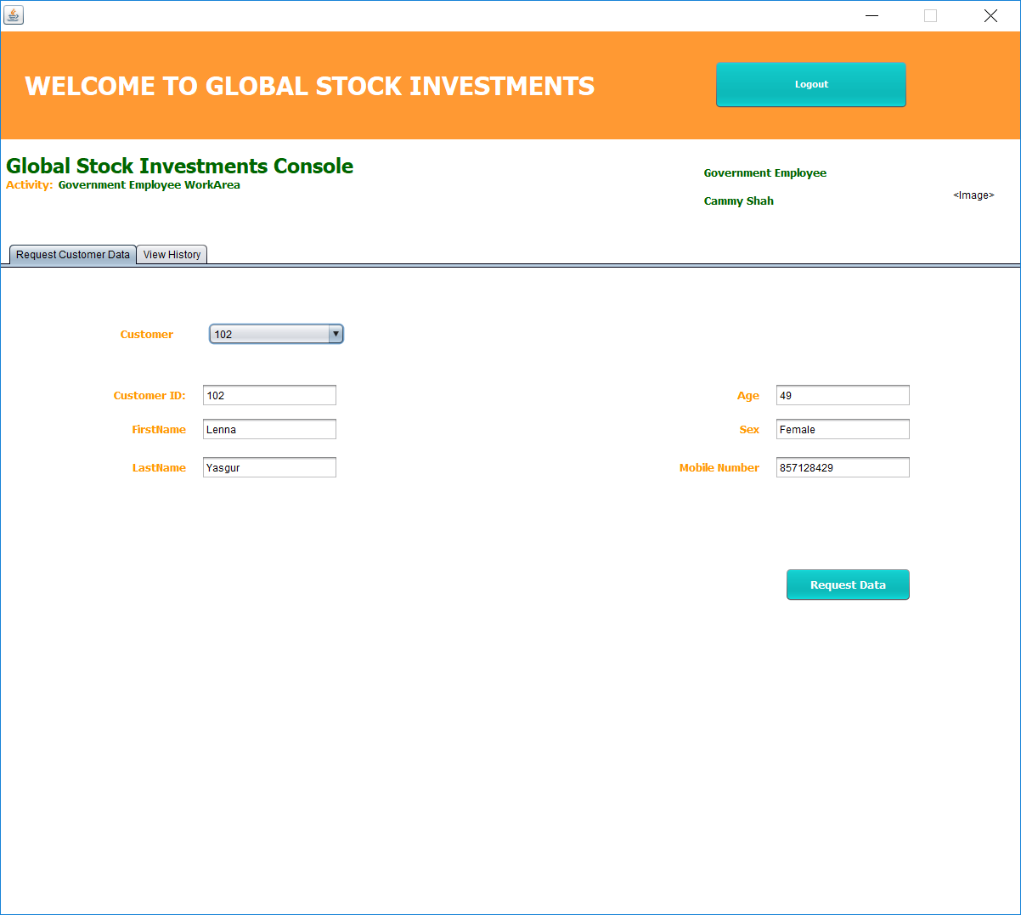
Government Employee will broadcast requests to all the Enterprises within the network to get details on Customer Investments
Government Employee WorkArea- Request Customer Data

Slide 30
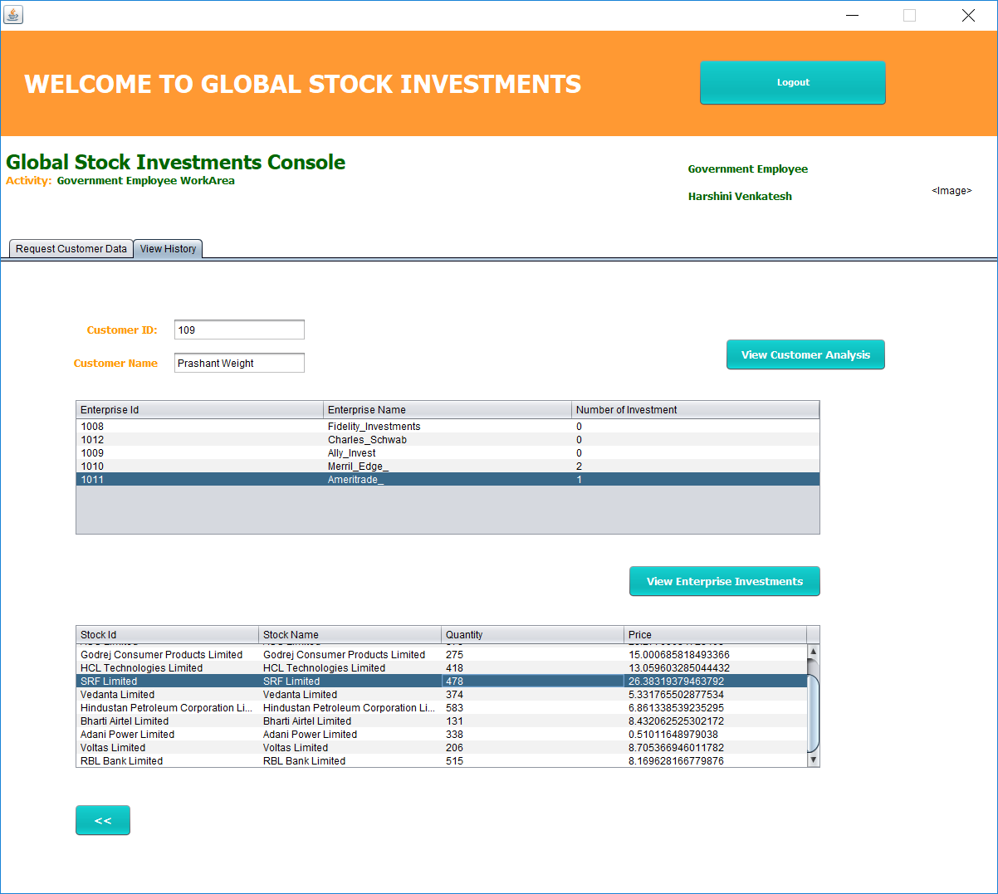
Government Employee will be able to view Customer’s investments globally as well as generate statistics based on customer’s investments
Government Employee WorkArea- View History

Slide 31
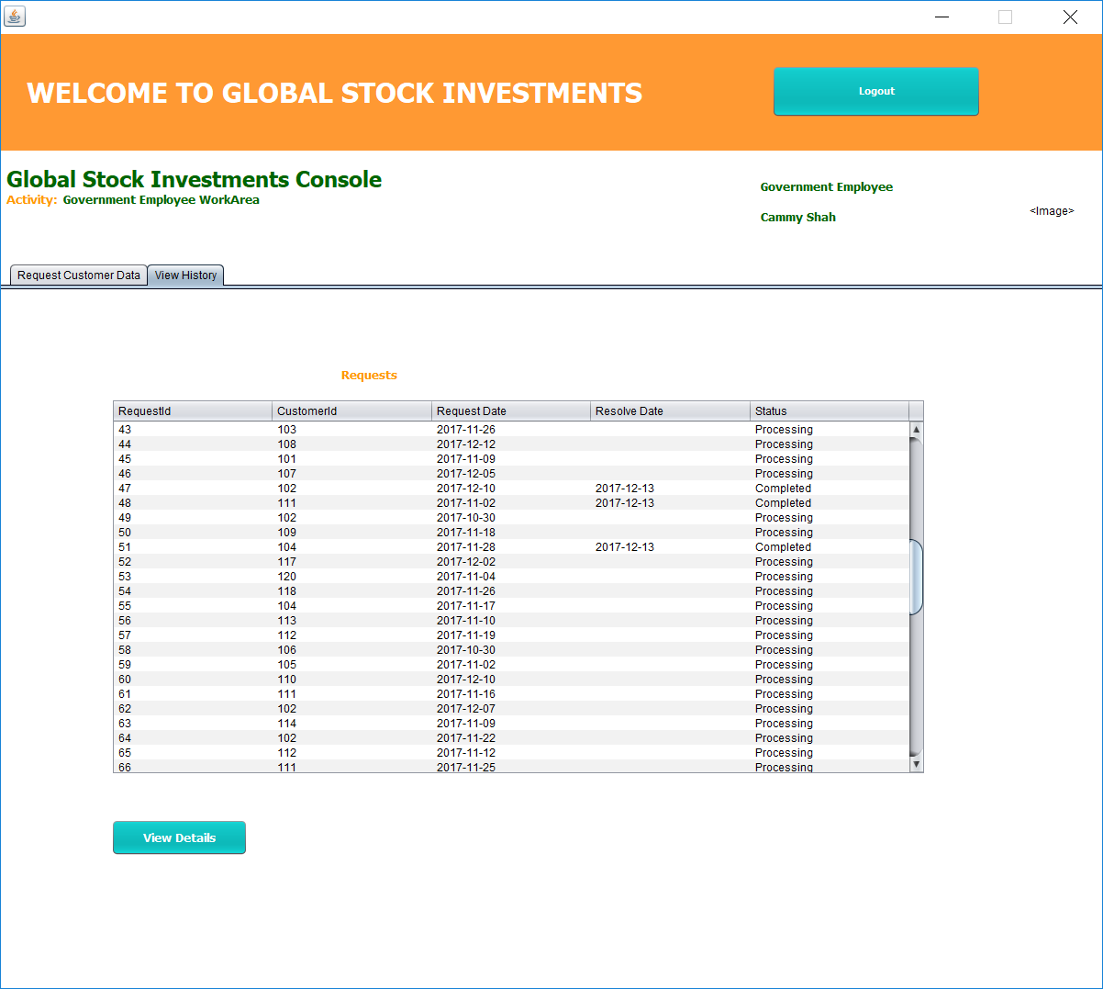

Slide 32
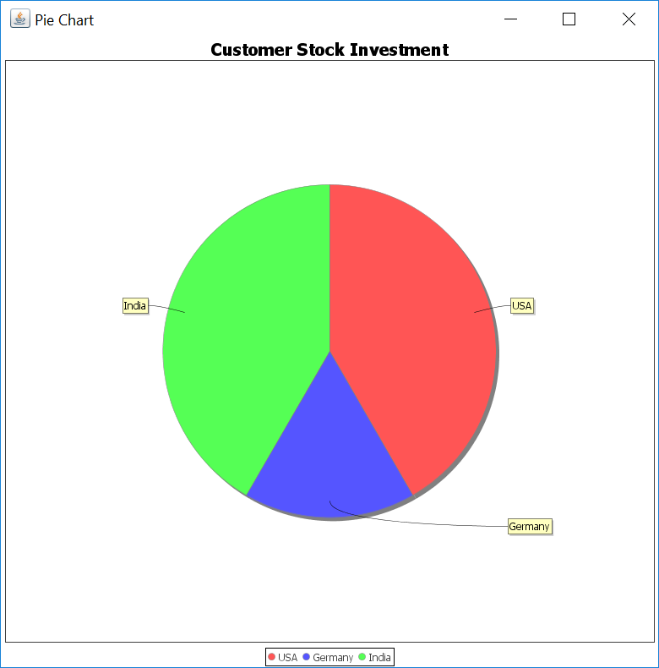

Slide 33
Regulatory Employee

Slide 34
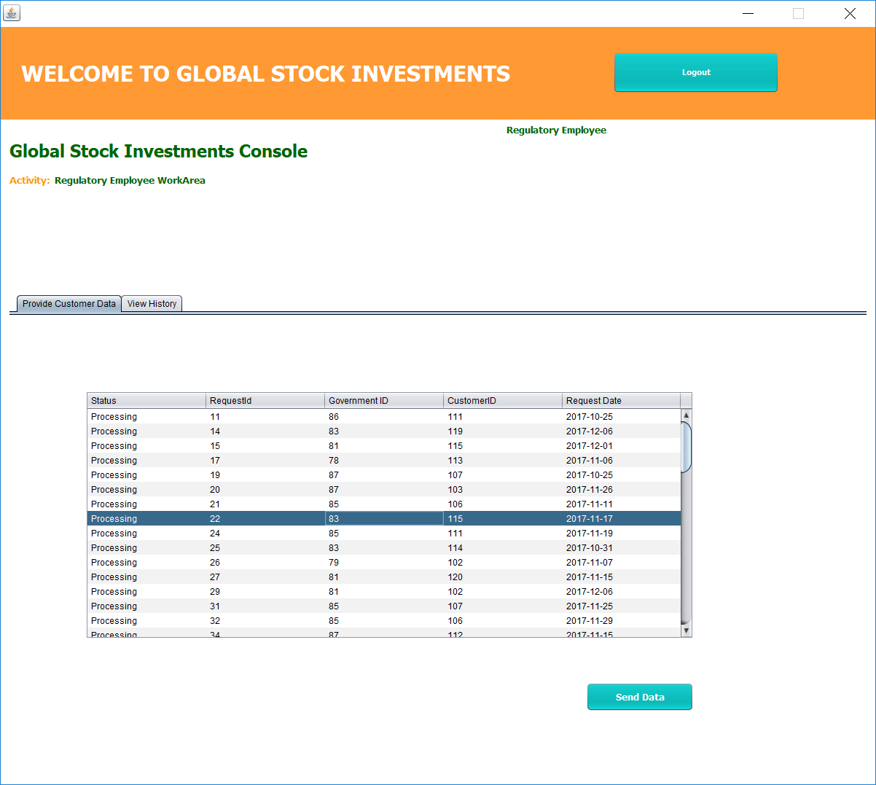
Regulatory Employee will provide details on Customer Investments to the local Government upon request
Regulatory Employee WorkArea- Provide Customer Data

Slide 35
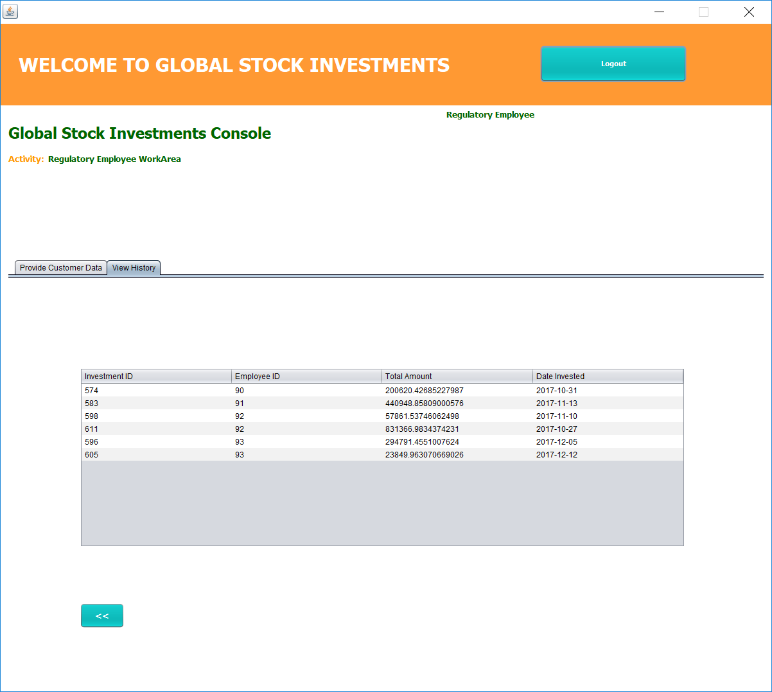
Regulatory Employee can view detailed history of all the requests from Government
Regulatory Employee WorkArea- View History

Slide 36
Expert Employee

Slide 37
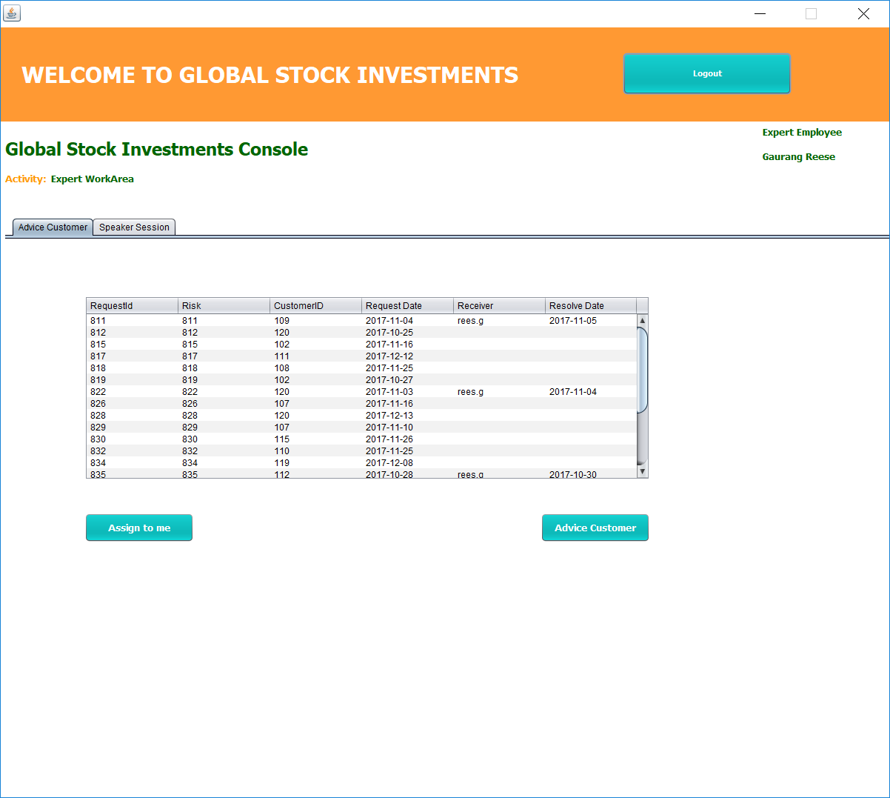
Expert Employee will be able to advice Customers on local stock investments upon request
Regulatory Employee WorkArea- Advice Customer

Slide 38
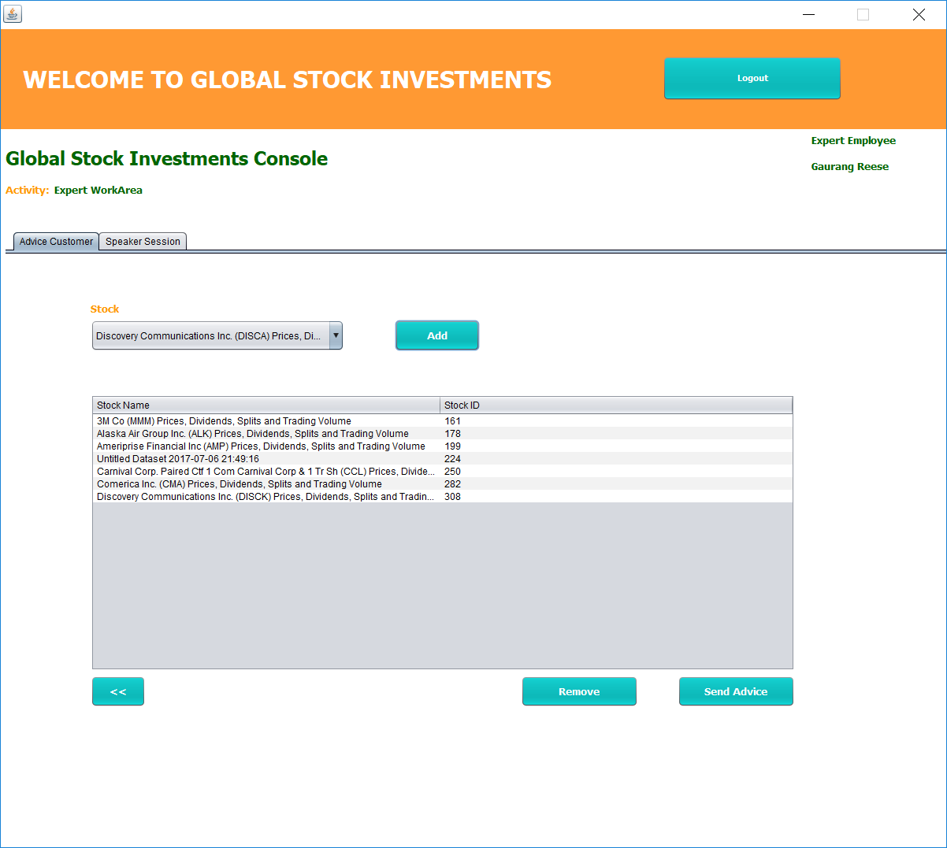

Slide 39
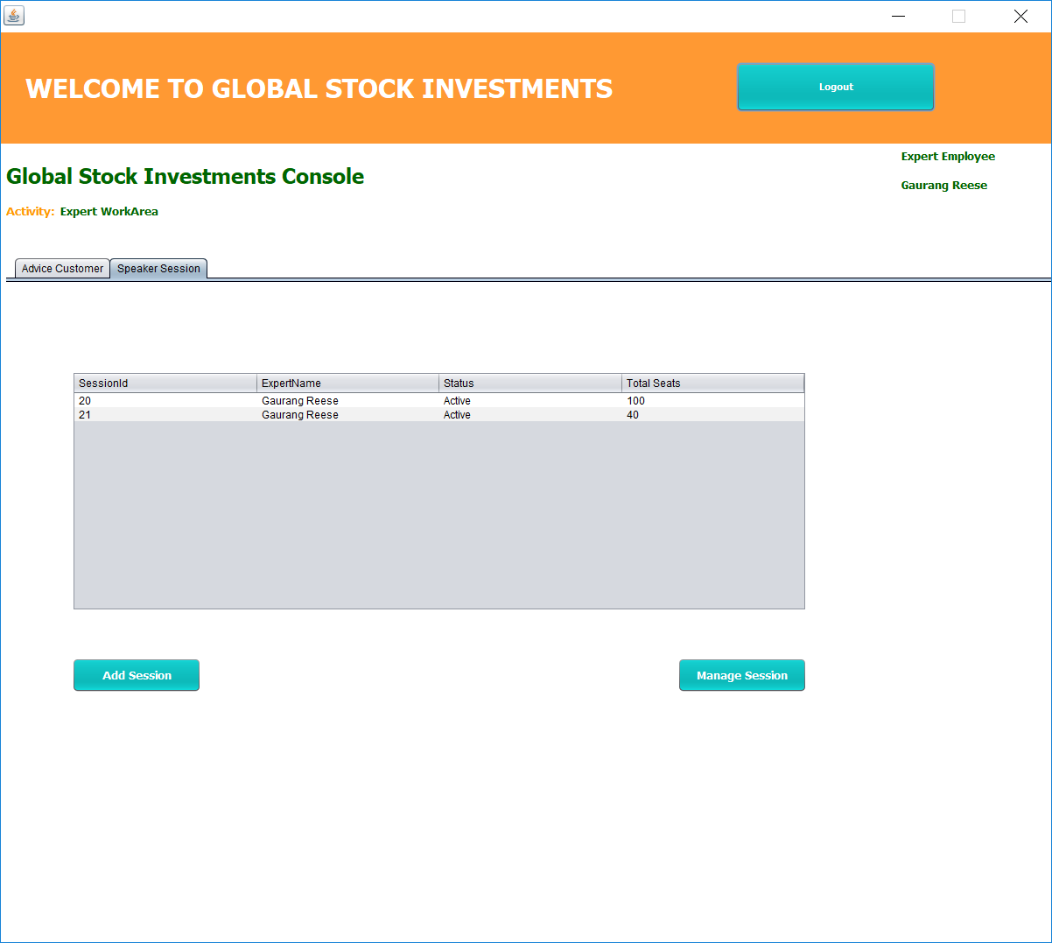
Expert Employee will be managing and conducting expert speaker sessions for which customers can register
Regulatory Employee WorkArea- Speaker Session

Slide 40
Highlighting Features

Slide 41
Live Stock APIs
The Stock Prices for multiple Networks are fetched dynamically using Live Stock APIs
Global Investments takes into consideration currency conversion for stocks belonging to particular network.

Slide 42
JFreeCharts
Government can view and analyze Customer’s interest in global stock markets present in his network
Customers will be able to see Stock History before deciding on making investments

Slide 43
Jasper Report
Investment Employee will be able to generate an Invoice Receipt for a particular Customer on processing his investment
Customer will also have access to this processed investment Invoice Receipt

Slide 44
Thank You

